Slide 1



CHM 103: Organic Chemistry I
Presented by:
Assoc Prof Okoli BJ MRSC, MACS
Department of Chemical Science,
Faculty of Science & Technology
Bingham University
The University with the difference
Bingham University

Slide 2
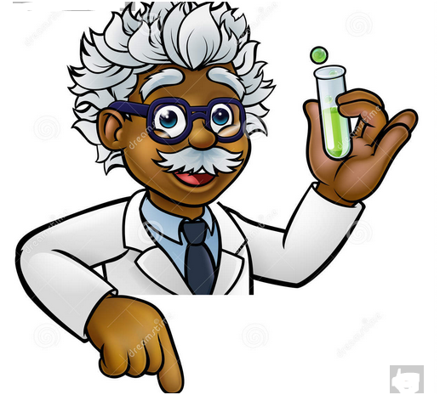
Reference Textbook
Follow the link and download
"Fundamentals of Organic Chemistry - Your No 1 Online Book Store" https://pbnbooks.com/product/fundamentals-of-organic-chemistry/
Reactions of alkanes
Oxidation Reactions of Alkane
Substitution Reactions of Alkanes
1. Oxidation Reactions of Alkane
Oxidation of alkanes gives different products under different conditions.
Complete oxidation or combustion iii. Catalytic oxidation
Incomplete oxidation iv. Chemical oxidation
Bingham University

Slide 3
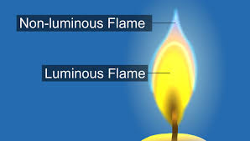
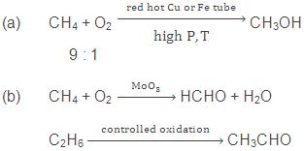
i. Complete oxidation or combustion: Alkanes burn readily with non-luminous flame in presence of air or oxygen. They are fuels
C_{n}H_{2n+2} + [(3n+1)/2]O₂ → nCO₂ + (n+1)H₂O; ΔH = -ve
CH₃ + 2O₂ → CO₂ + 2H₂O; ΔH = -ve
Incomplete oxidation: Incomplete oxidation of alkanes in limited supply of air gives carbon black and carbon monoxide.
2CH₄ + 3O₂ → 2CO + 4H₂O
CH₄ + O₂ → C + 2H₂O
iii. Catalytic oxidation:
Lower alkanes are easily converted to alcohols and aldehydes under controlled catalytic oxidation.
Bingham University

Slide 4
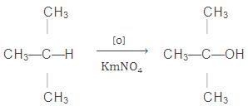
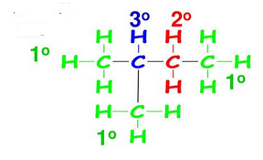
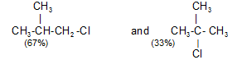
iv. Chemical oxidation: Tertiary alkanes are oxidized to tertiary alcohols by KMnO₄
2. Substitution Reactions of Alkanes
i. Halogenation of Alkanes: Chlorination is
Initiated by photo irradiation, heat or catalysts,
and the extent of chlorination depends largely on the amount of chlorine
to give a mixture of all possible isomeric monochlorides.
The isomers(products) are formed in unequal amounts, due to difference in reactivity of primary, secondary and tertiary hydrogen atoms. The order of ease of substitution is Tertiary Hydrogen > Secondary Hydrogen > Primary Hydrogen
Chlorination of isobutane at 300 ºC gives a mixture of two isomeric monochlorides
Bingham University

Slide 5
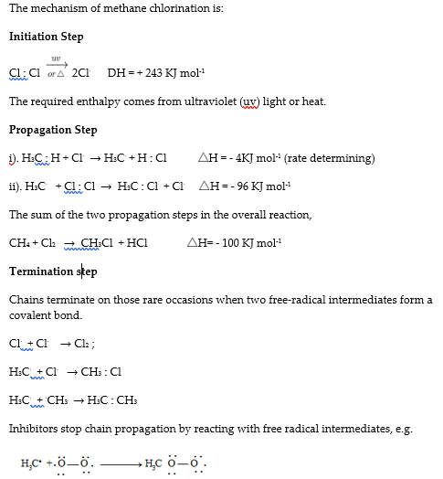
Bingham University

Slide 6
Three factors affect the product yield obtained from the halogenation of complex alkanes:
probability factor
reactivity of hydrogen
reactivity of halogen
Probability Factor: This factor is based on the number of each kind of H atom in the molecule. E.g, in CH₃CH₂CH₂CH₃ there are six equivalent 1º H’s and four equivalent 2º H’s. The ratio of abstracting a 1ºH are thus 6 to 4, or 3 to 2.
Reactivity of H· : The order of reactivity of H is 3º > 2º > 1º.
Reactivity of halogen · : The more reactive Cl· is less selective and more influenced by the probability factor. The less reactive Br· is more selective and less influenced by the probability factor, as summarized by the Reactivity-Selectivity Principle.
If the attacking species is more reactive, it will be less selective, and the yields will be closer to those expected from the probability factor.
At room temperature, for example, the relative rate per hydrogen atom are 5.0:3.8:1.0. Using these values, we can predict quite well the ratio of isomeric chlorination products from a given alkane. For example:
Bingham University

Slide 7
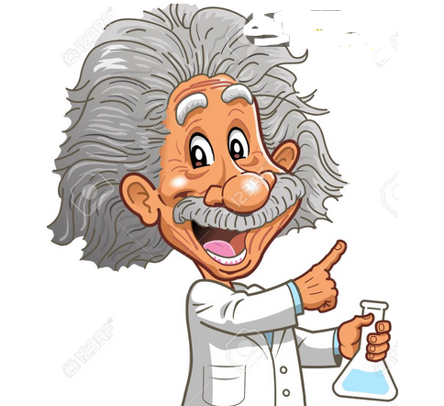
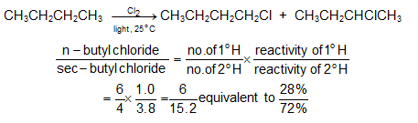

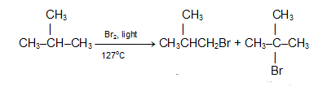
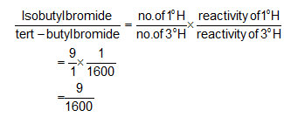
Inspite of these differences in reactivity, chlorination rarely yields a great excess of any single isomer.
The same sequence of reactivity, 3º > 2º > 1º, is found in bromination, but with enormously larger reactivity ratios. At 127ºC, for example, the relative rates per hydrogen atom are 1600:82:1. Here, differences in reactivity are so marked as vastly to outweigh probability factors. Hence, bromination gives selective product.
Hence, tert-butyl bromide happens to be the
exclusive product (over 99%).
Bingham University

Slide 8
Alkenes
Alkenes are a class of hydrocarbons
unsaturated compounds with at least one carbon-to-carbon double bond.
Described as olefins.
more reactive than alkanes due to the presence of the double bond.
molecular formulas of these unsaturated hydrocarbons reflect the multiple bonding of the functional groups:
CnH2n
Here is a chart containing the systemic name for the first twenty straight chain alkenes.
Name Molecular formula
Ethene C2H4
Propene C3H6
Butene C4H8
Pentene C5H10
Hexene C6H12
Heptene C7H14
Octene C8H16
Nonene C9H18
Decene C10H20
Name Molecular formula
Undecene C11H22
Dodecene C12H24
Tridecene C13H26
Tetradecene C14H28
Pentadecene C15H30
Hexadecene C16H32
Heptadecene C17H34
Octadecene C18H36
Nonadecene C19H38
Eicosene C20H40
Bingham University

Slide 9
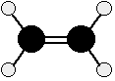
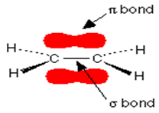
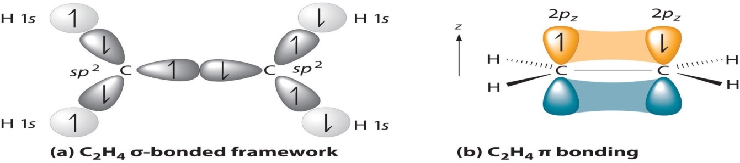
i. Bonding in the alkenes
The double bond between the carbon atoms is,
two pairs of shared electrons.
One of the pairs of electrons is held on the line between the two carbon nuclei
the other is held in a molecular orbital above and below the plane of the molecule.
In this diagram, the line between the two carbon atoms represents a normal bond - sort of bond is called a sigma bond.
The other pair of electrons is found somewhere in the shaded part above and below the plane of the molecule. This bond is called a pi bond.
The pi electrons are not as fully under the control of the carbon nuclei as the electrons in the sigma bond and, because they lie exposed above and below the rest of the molecule, they are relatively open to attack .
Bingham University

Slide 10
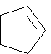
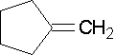
ii. Common names
Remove the -ane suffix and add -ylene. There are a couple of unique ones like ethenyl's common name is vinyl and 2-propenyl's common name is allyl. That you should know are...
• vinyl substituent H2C=CH-
• allyl substituent H2C=CH-CH2-
• allene molecule H2C=C=CH2
• isoprene
Endocyclic Alkenes
Endocyclic double bonds have both carbons in the ring Cyclopentene
Exocyclic Alkenes
Exocyclic double bonds have only one carbon as part of the ring. Methylenecylopentane
Bingham University

